Slide 1


Slide 2
Chapter 01. Company Profile
1. About us
2. Company Overview
Chapter 02.
Business Introduction
1. Distribution of Medical Aesthetic Device
2. OEM & ODM
Services
3. Company Certifications
Chapter 03.
Future Vision & Global Strategy
1. R&D Roadmap
2. Global Expansion Plan

Slide 3

Chapter 01. Company Profile

Slide 4
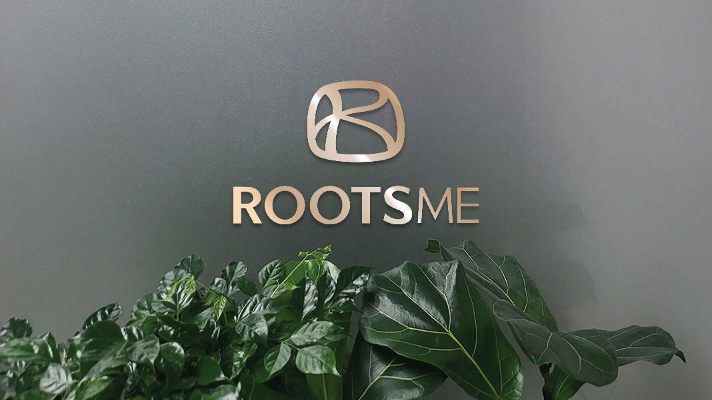
1. About us
CEO’s Message
rooted in fundamentals,
we create the future of beauty through innovation..
Rootsme Co., Ltd. is a beauty and healthcare company dedicated to developing and manufacturing next-generation RF Microneedles, built on professional research and innovative technology, with the ultimate goal of promoting healthy and beautiful lives for our customers.
In addition, we provide OEM & ODM services for aesthetic devices tailored to diverse customer needs, delivering efficient and differentiated business solutions.
Moving forward, Rootsme will continue to achieve sustainable growth through ongoing communication with our customers and relentless research and innovation, striving to become a global leader in health and beauty devices.

Slide 5

1. About us
Rootsme Co., Ltd.
Established: 2024
Headquarters: #1504, Hanwha Biz Metro 1, 242 Digital-ro, Guro-gu, Seoul, Korea
Business Area: Manufacturing and global distribution of medical and aesthetic devices
ROOTS (根) + ME (美) = ROOTSME
Rootsme explores the origins of beauty and brings them to life.
Vision: Shaping global beauty & healthcare, bringing happiness to life.​
Mission: Advanced beauty & medical technology — younger, simpler, more beautiful life

Slide 6
2. Company Overview
2024.01 Foundation of ROOTSME Co. Ltd.
2024.08
R.THERMA RF Micro Needle development
2024.09
R.THERMA Market launch
2025.09
Attended KIMES Busan
2025.03
Taiwan authorized distributor
2024.11
R.THERMA KC certified
HK authorized distributor
2025.05
China authorized distributor
2025.04
R.THERMA CE(LVD)certified
Israel authorized distributor
2025.12
Factory registered
2025.10
INTERCHARM Russia
2025. 11
HK COSMOPROF

Slide 7
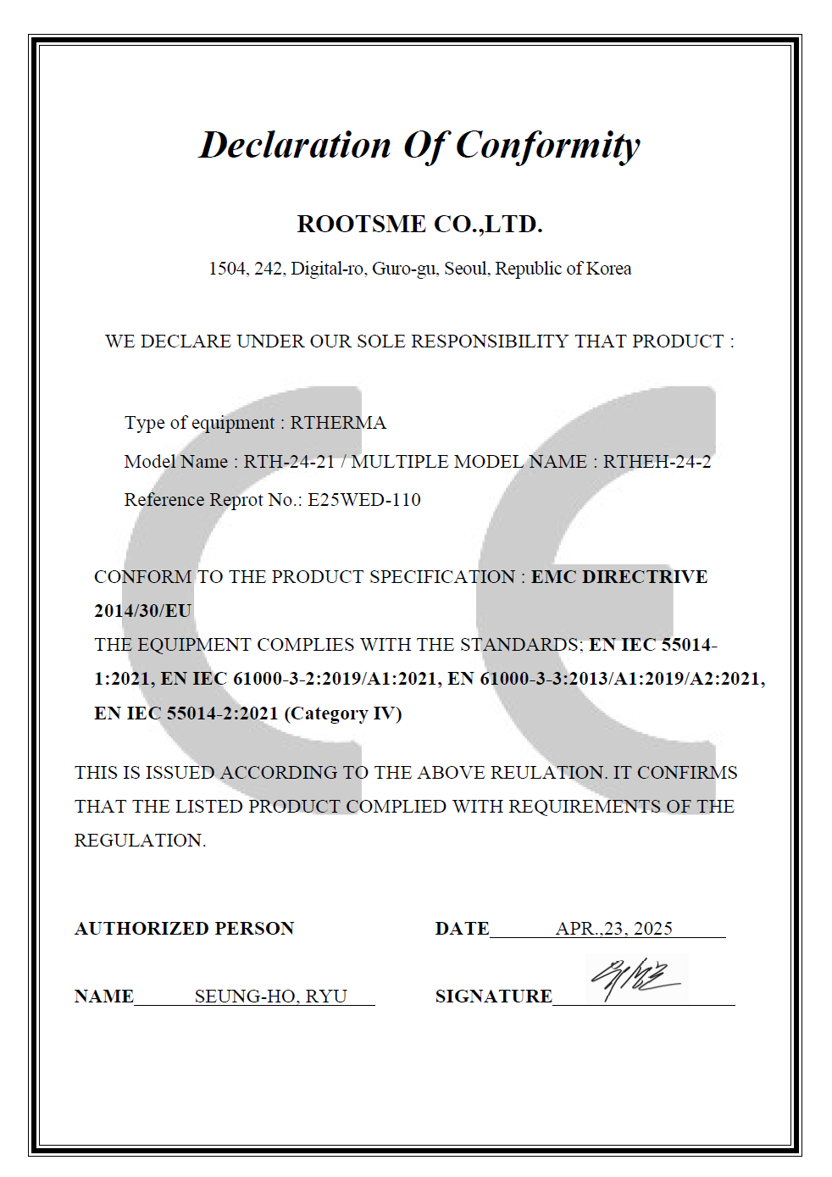
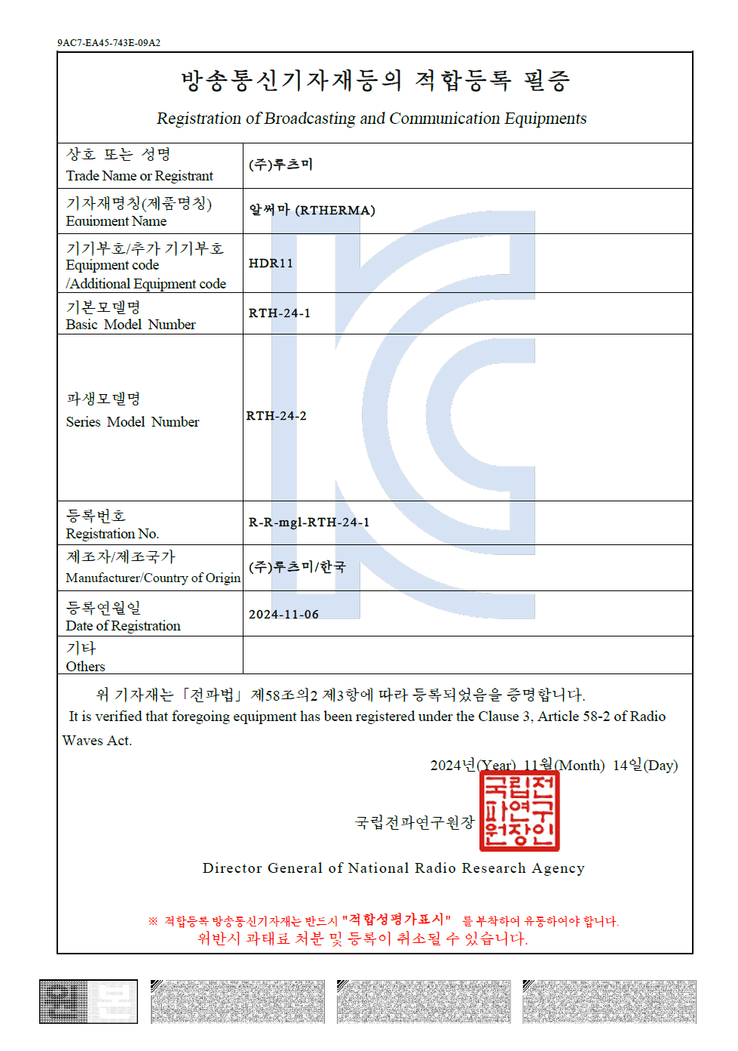
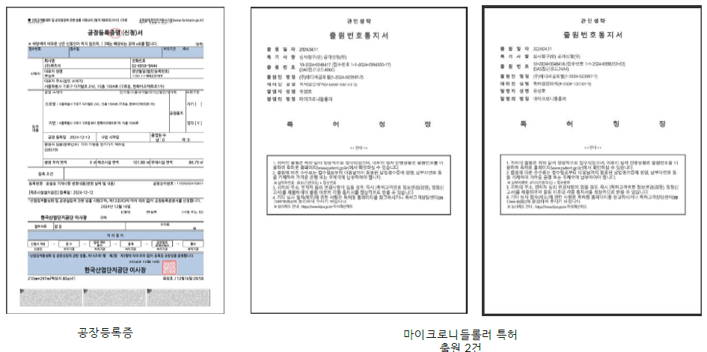
3. Company Certifications

Slide 8
Chapter 02. Business Introduction

Slide 9

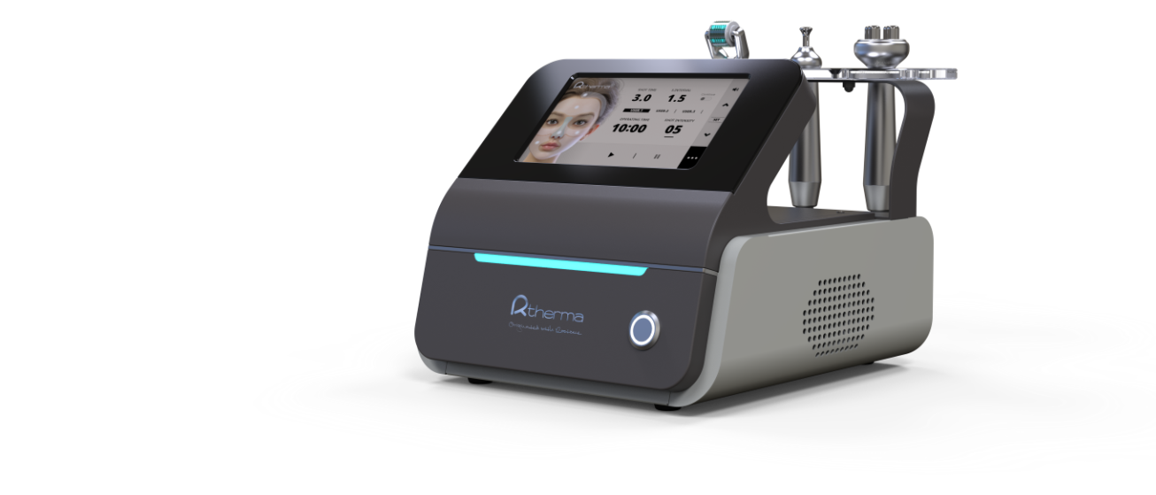
1. Distribution of Medical Aesthetic Device
No anesthesia Effective drug delivery Massage toning

Slide 10

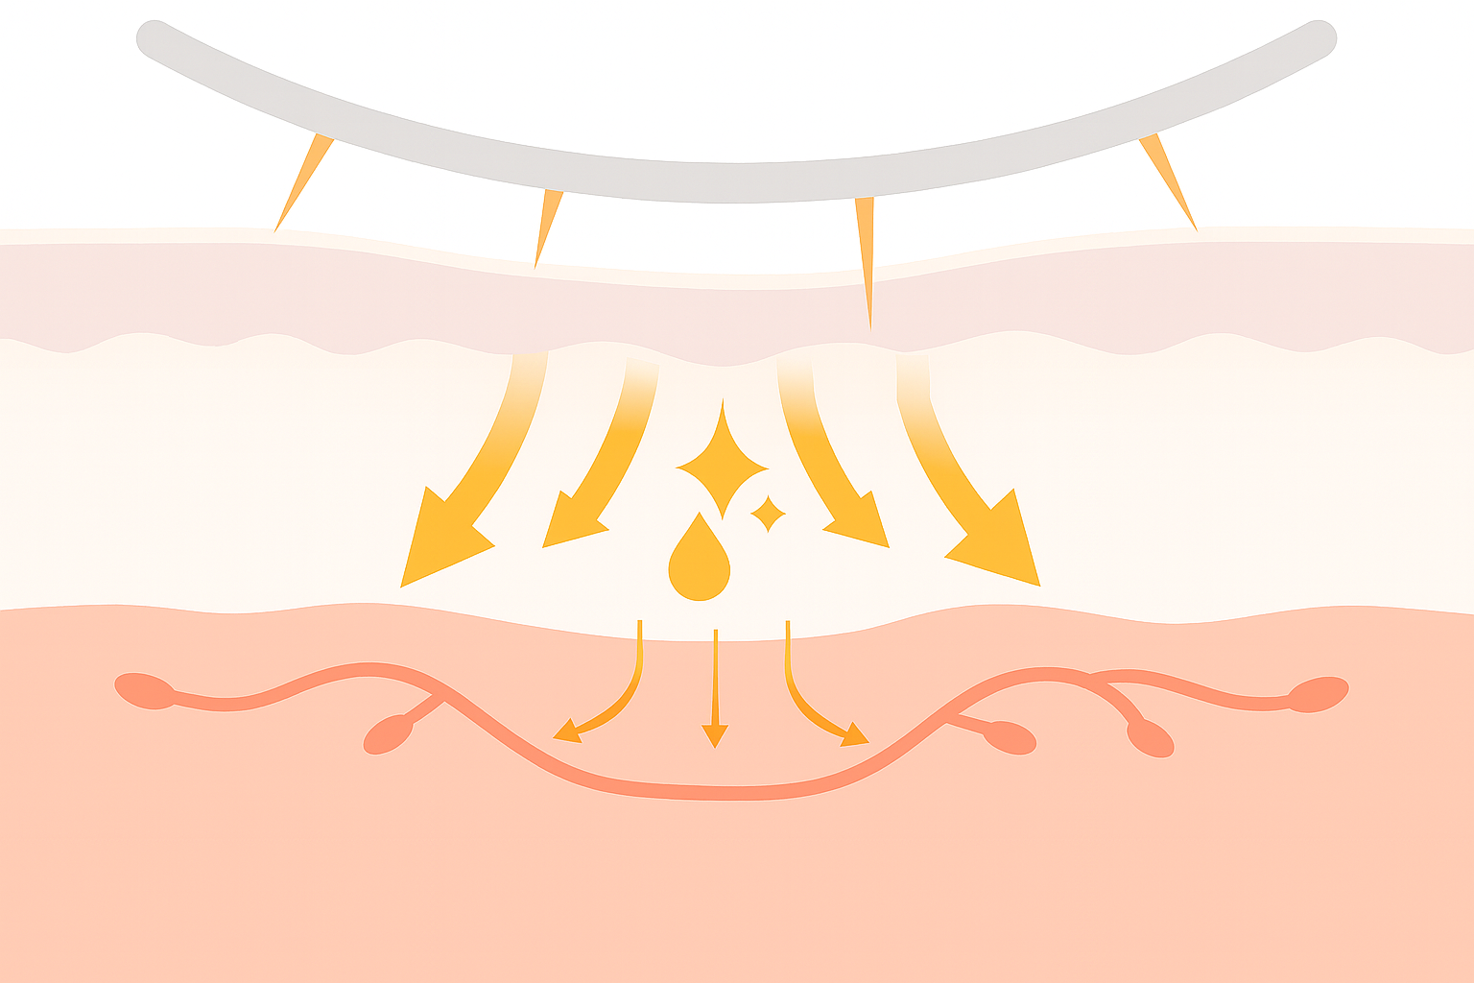
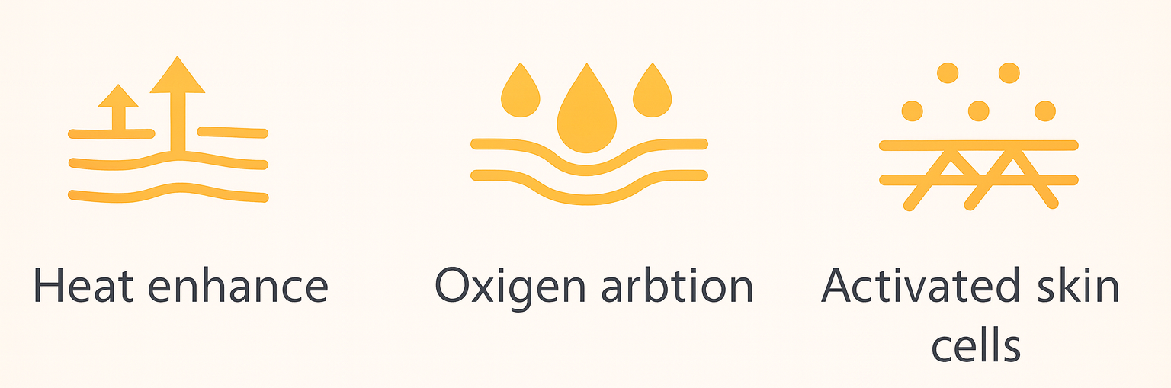
1. Distribution of Medical Aesthetic Device
1. Principle of Micro-needling
Micro-needles penetrate the skin and deliver RF energy directly.
**Micro-needles create microscopic channels in the skin.
Maximizes the delivery of customized solutions to skin conditions.
Promotes new cell formation and remodeling, improving skin elasticity, minimizing pores, reducing wrinkles, and providing brightening effects.
2. RF effects
RF energy penetrates the epidermis and dermis, generating deep heating within the skin.
  Activates microvascular blood circulation.
  Increases oxygen and nutrient supply.
  Promotes new collagen production and enhances skin elasticity.

Slide 11
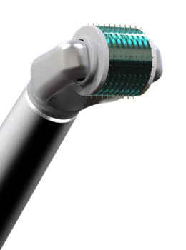
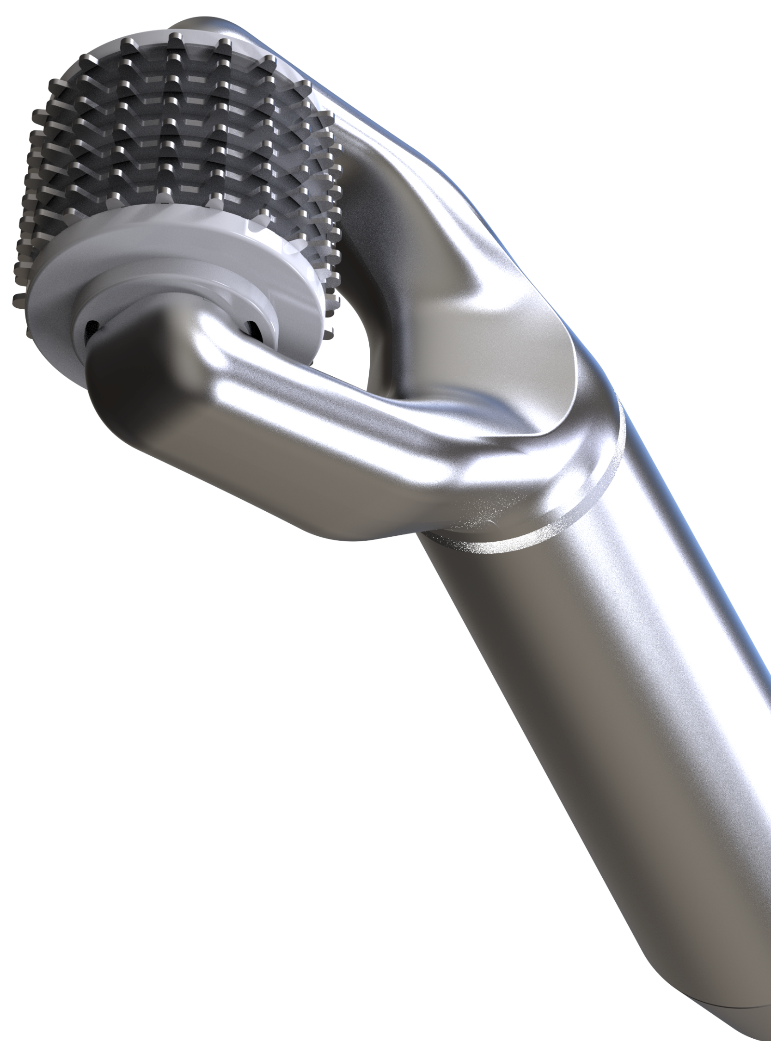
1. Distribution of Medical Aesthetic Device
Key Points
“World’s First Rolling MTS-type RF Micro Needle”
Patent No.10-2024-0048418 / patent No.10-2024-0048417
Ergonomically Designed Handpiece Specialized for Facial Contours
Treatment Key Points
No Anesthesia · No Downtime
Low-pain, simple procedure → High patient satisfaction
Delivers effects equivalent to fractional RF invasive treatment
Simultaneous penetration of RF energy + solution → Enhanced drug and pharmaceutical absorption
Rolling Micro-needling
System(4MHz)
Rolling Non-needling
System(4MHz)

Slide 12

1. Distribution of Medical Aesthetic Device
Needle Format | Depth | Treatment Area / Features
Rolling Micro-needling System(4MHz) | 0.25 mm | Eyes, Nose, and Forehead – Optimized for precise and delicate care
 | 0.5 mm | Chin, Cheeks, Acne → Intensive Trouble Care
 | 1.0 mm | Double Chin, Stretch Marks → Intensive Firming & Body Care
Rolling Non-needling System(4MHz) | - | For Sensitive Skin → Gentle Care without Irritation

Slide 13
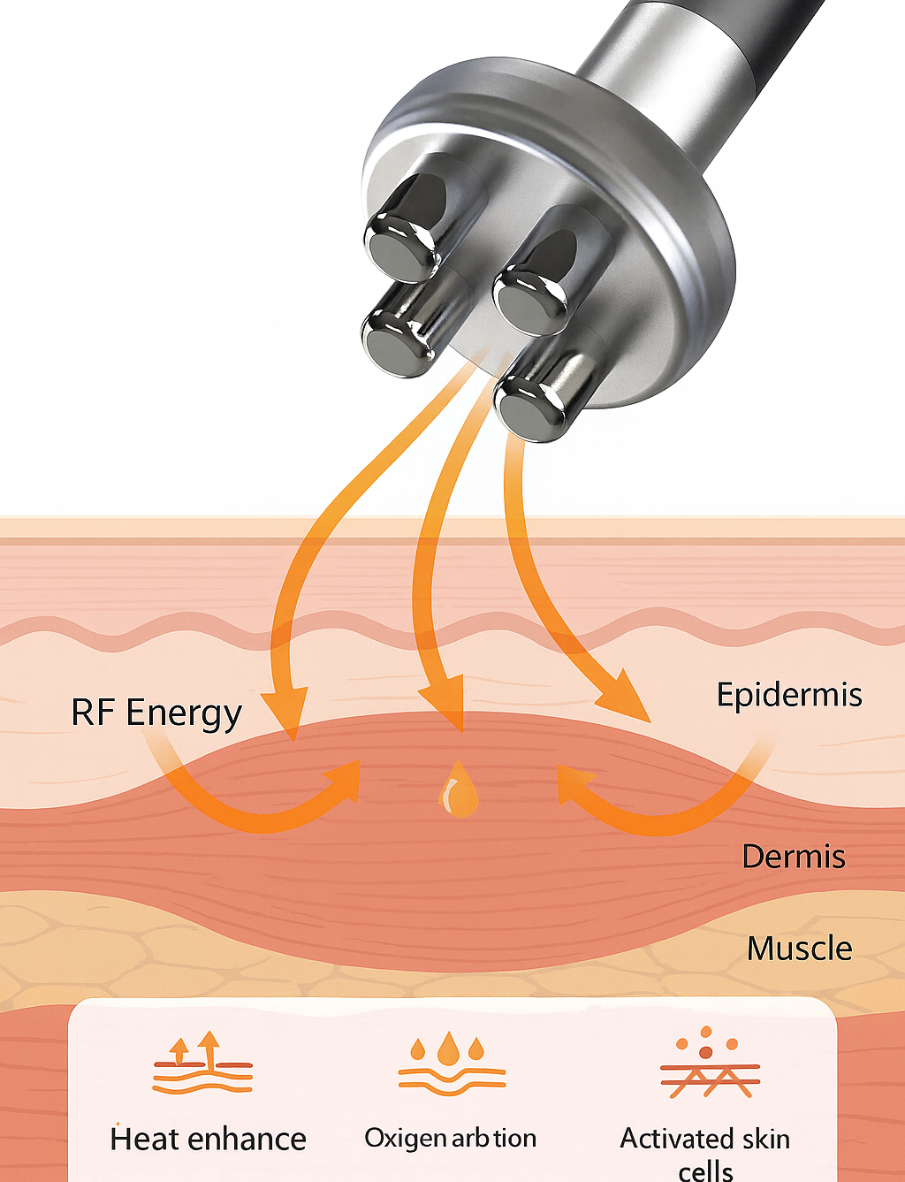

1. Distribution of Medical Aesthetic Device
Dual Functions System(1~3KHz)
Mild-Frequency Stimulation
  Four ergonomic electrodes seamlessly follow facial contours, delivering stable low-frequency energy for effective muscle stimulation.
  Gentle micro-vibrations activate natural muscle contraction and relaxation → enhancing lifting and firming effects.
  Provides a soothing massage effect by pressing and relaxing the muscles for refreshed, revitalized skin.
Thermal Energy Effect
  Increases the temperature of skin and soft tissues to deliver deep thermal stimulation
  Enhances oxygen absorption within skin tissues
  Promotes blood circulation and skin revitalization, creating a healthier skin environment

Slide 14
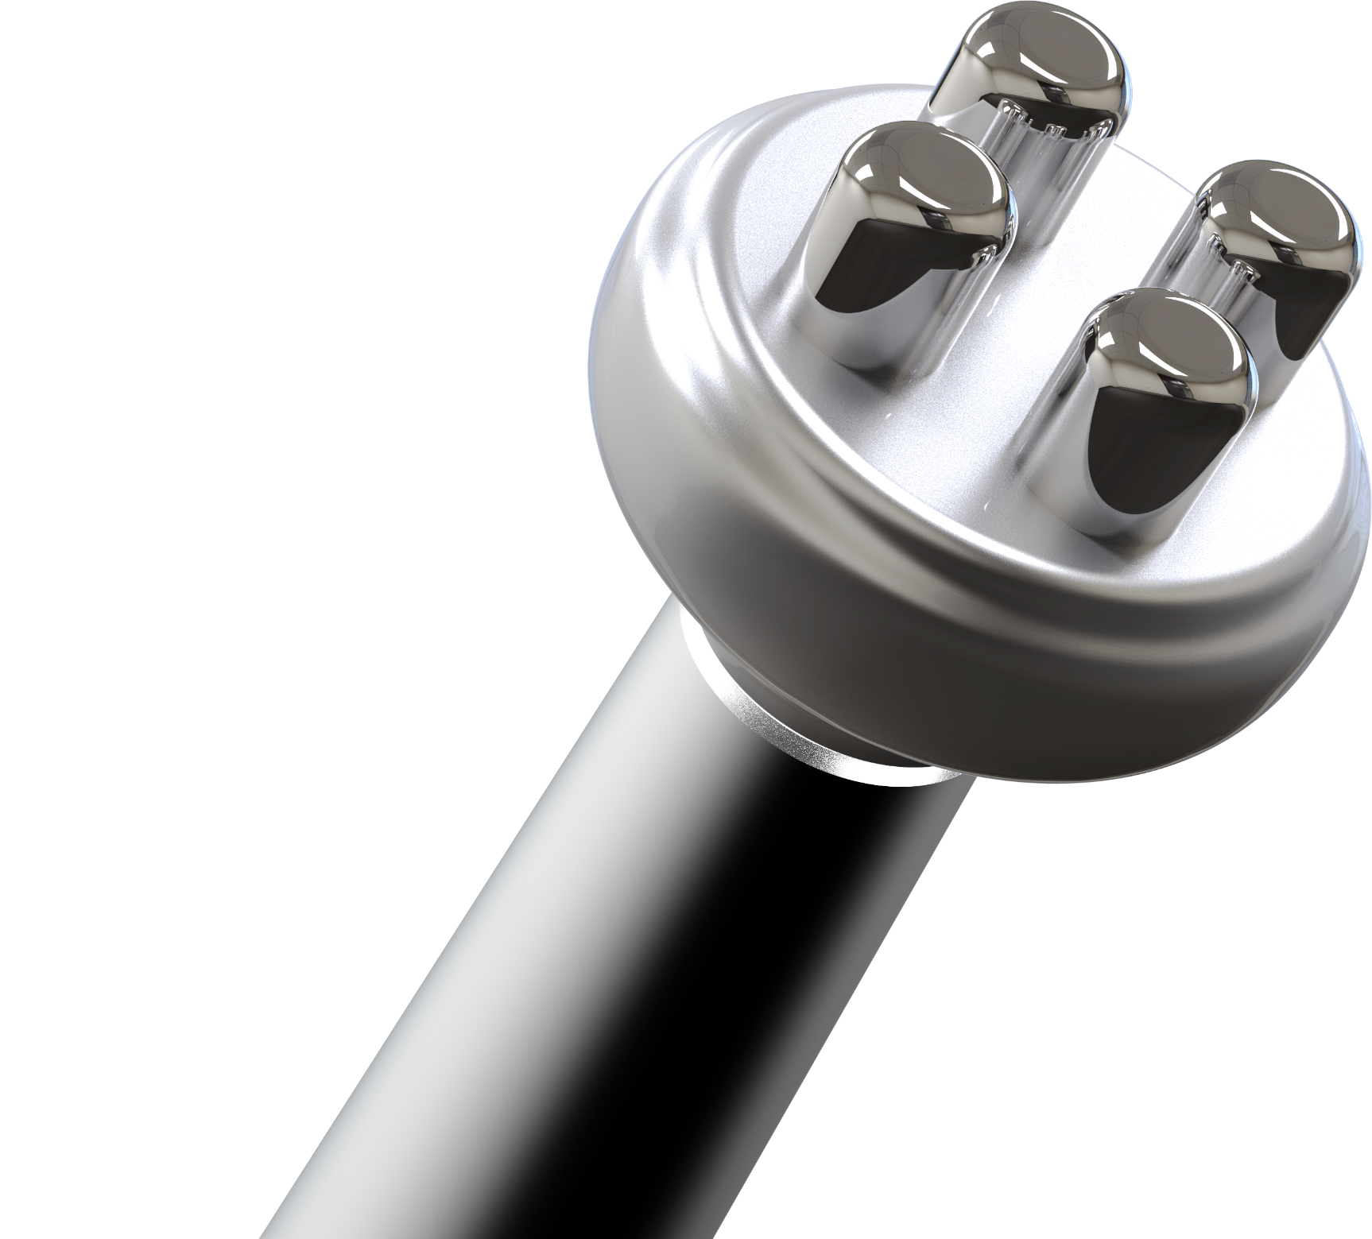
1. Distribution of Medical Aesthetic Device
Dual Functions System(1~3KHz)
Key Points
Mechanism of Action
Specialized in Muscle Contraction & Relaxation
  → Maximizes facial elasticity and lifting effect
Ergonomic 4-Electrode Design
  → Synergistic effect with Gua Sha
Wide range of Frequency Support (1~3 kHz)
  → Customized care for various skin types and clients
Comfortable and Natural Energy Delivery
  → Provides treatment without discomfort
Low-Frequency Muscle Stimulation
  → Induces repetitive contraction and relaxation
Micro-Vibration Massage Effect
  → Presses and relaxes the muscles
Improved Blood & Lymph Circulation
  → Reduces swelling and enhances skin vitality
Enhanced Facial Contour
  → Lifting & contour improvement

Slide 15

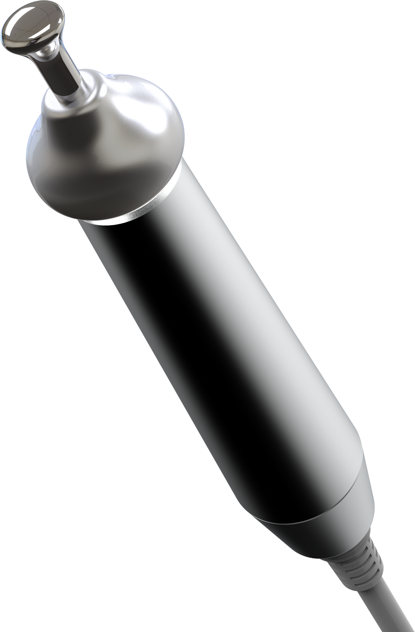
1. Distribution of Medical Aesthetic Device
Eyes Care System (4MHz)
Mechanism of Action
Thermal Energy Irradiation
  → Supplies abundant oxygen and nutrients
Promotes Blood & Lymph Circulation
  → Eliminates surrounding waste and harmful oxygen
Maximized Drug Absorption
  → Deep penetration of Functional ingredients
Enhances Eye Contour
  → Improves lifting & facial contouring
Key Points
Specialized for Periorbital Muscles
  → Improves sagging upper & lower eyelids, wrinkles, and dark circles
Ergonomic Single-Electrode Design
  → Enables precise treatment of small areas such as nasolabial folds and eye contours
Comfortable and Natural Energy Delivery
  → Provides comfort treatment

Slide 16








2. OEM & ODM Services
Customized Solutions for Global Partners
"ROOTSME delivers differentiated global business through OEM & ODM tailored to customer needs."
Business Process Diagram
Customizing
Flexible Manufacturing
High Quality Standards
OEM | ODM
Customer-designed products manufactured by a contracted producer | Manufacturer-designed and developed products produced under the client’s brand
Providing Product Planning and Design, and Brand Management | Focus on Brand and Sales Strategy
Production based on customer designs | One-stop service from product planning to production
**-Easy to reflect customer requirements Maintain brand identity** | **-Faster market entry Reduced development cost and time**
High R&D cost and time burden for customers – advanced technology required | ** Difficult to differentiate High dependence on manufacturer**
ROOTSME with unique technology and design | Startups seeking rapid launch and companies aiming to reduce costs
Customer Needs → Product Planning → Prototype Development → Clinical Trials/Certification → Global Distribution
Competitive Edge(Why ROOTSME?)
. World’s first rolling RF technology with differentiated IP
. Capability to perform both OEM & ODM (one-stop support: development – production – certification – distribution)
. Global network (expanding in Japan, Vietnam, Hong Kong, Middle East, Europe)
. Fast response & customized solutions

Slide 17
Chapter 03. Future Vision & Global Strategy

Slide 18
1. R&D Roadmap
Next-Generation Product Development Plan
R.SONA (Device for Skin Booster, to be launched)
Maximizes the synergy between drugs and skin boosters
Minimizes consumable usage → reduces maintenance costs
1. Core Technology Modes
2. Development Roadmap
3. Market Strategy
4. Mid-to-Long Term Vision
Cavitation System
. 140 kHz frequency for stronger tissue penetration
. Enhances drug absorption in the dermis and stimulates regeneration
LDM System
. 3/10/17 MHz triple frequency application
. Enables precise targeting of epidermis, dermis, and subcutaneous layers
4MHz RF System
. Provides stable and uniform energy delivery
. Minimizes side effects while maximizing treatment effectiveness
Prototype Establishment (2025)
Clinical Trials by Core Modes
Mass Production & Global Launch (Sep 2025))
Smart Factory-Based Production System
Stepwise Expansion into Emerging Asian Markets (China, ASEAN, Middle East)
Premium Positioning: Collaboration with global KOLs (Key Opinion Leaders), academic presentations
Differentiation Points:
Precision customized treatment based on multi-frequency
Non-invasive & safety-focused
Business Model: Aesthetic clinics (B2B) + Expansion into home-care line (B2C)
Establish R.sona as a Global Standard Device
Not just equipment sales, but positioning as a customized device that sets the global standard for next-generation beauty & health devices

Slide 19
2. Global Expansion Plan
1. Strategy for Entering Key Overseas Markets
2. Local Partnerships and Collaboration Strategies
Advanced Markets: U.S. & Europe:
  Secure global certifications such as FDA and CE
  Focus on the premium medical and aesthetic device markets
  Strengthen brand awareness through participation in global conferences
  and exhibitions (IMCAS, MEDICA, etc.)
Advanced Asian Markets: Japan & China:
  Japan: Obtain PMDA certification and build credibility based on clinical data
  China: Obtain NMPA certification and pursue localized sales strategies
  Expand market presence by leveraging the value of K-Beauty branding
Emerging Markets: Southeast Asia & Middle East:
  ASEAN: Promote marketing strategies linked with K-Beauty
  and Korean Wave (Hallyu)
Middle East: Target premium clinic chains centered in Dubai
  Provide a competitive product lineup along with localized, customized services
Global Distributors:
  Strategic alliances with regional distributors
  Stable supply chain through long-term partnerships
Key Opinion Leaders (KOLs):
  Partnering with dermatologists and aesthetic leaders
  Sharing clinical results and case studies → building trust
Local Joint Ventures & OEM/ODM:
  Considering establishment of joint ventures with local companies
  Developing market-customized products through OEM·ODM collaboration
Academic & Exhibition Participation:
  Continuous participation in global exhibitions such as COSMOPROF, IMCAS,
  and Dubai Derma
  Conducting joint research with local academic societies and seminars

Slide 20
Thank you !

