Slide 1
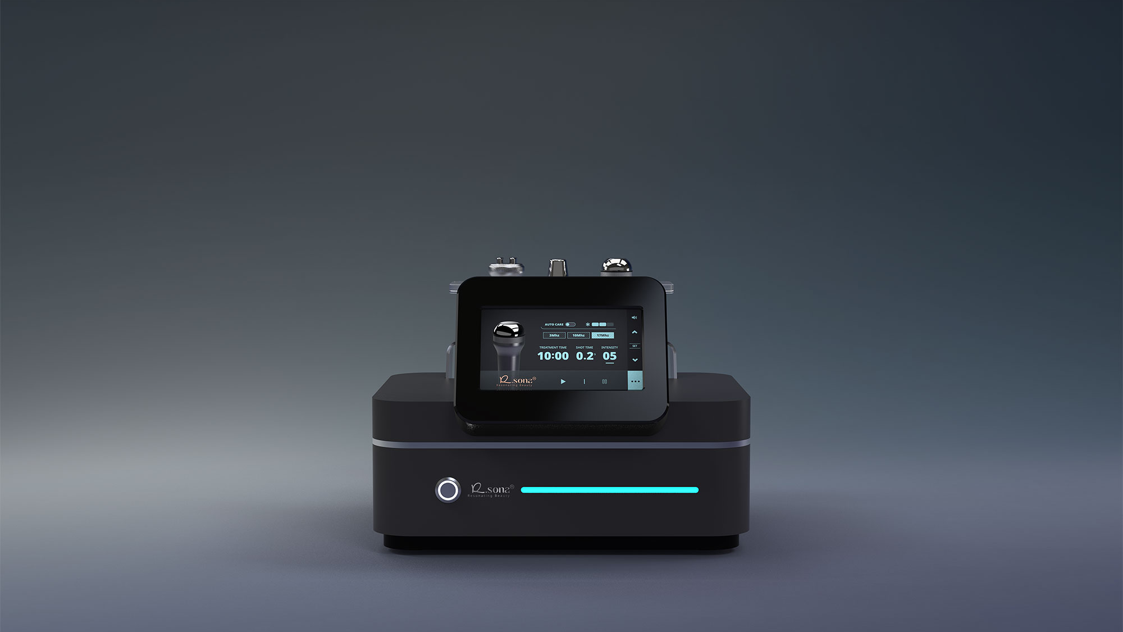

3-Way Dynamic System™

Slide 2
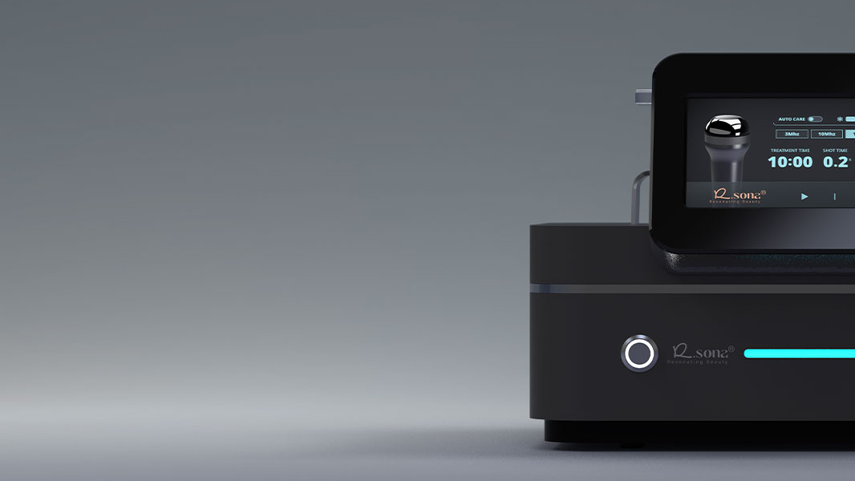

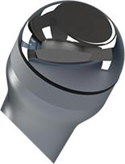

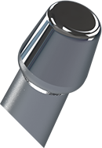

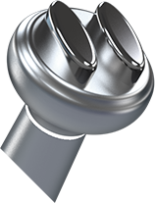


Resonating Beauty
(Adaptive Frequency System)
(Microbubble Absorption System)
Customizable
Multi-Function Platform
(Dual Frequency System)
, Innovating Aesthetic Medical Devices for Global Healthcare.

Slide 3
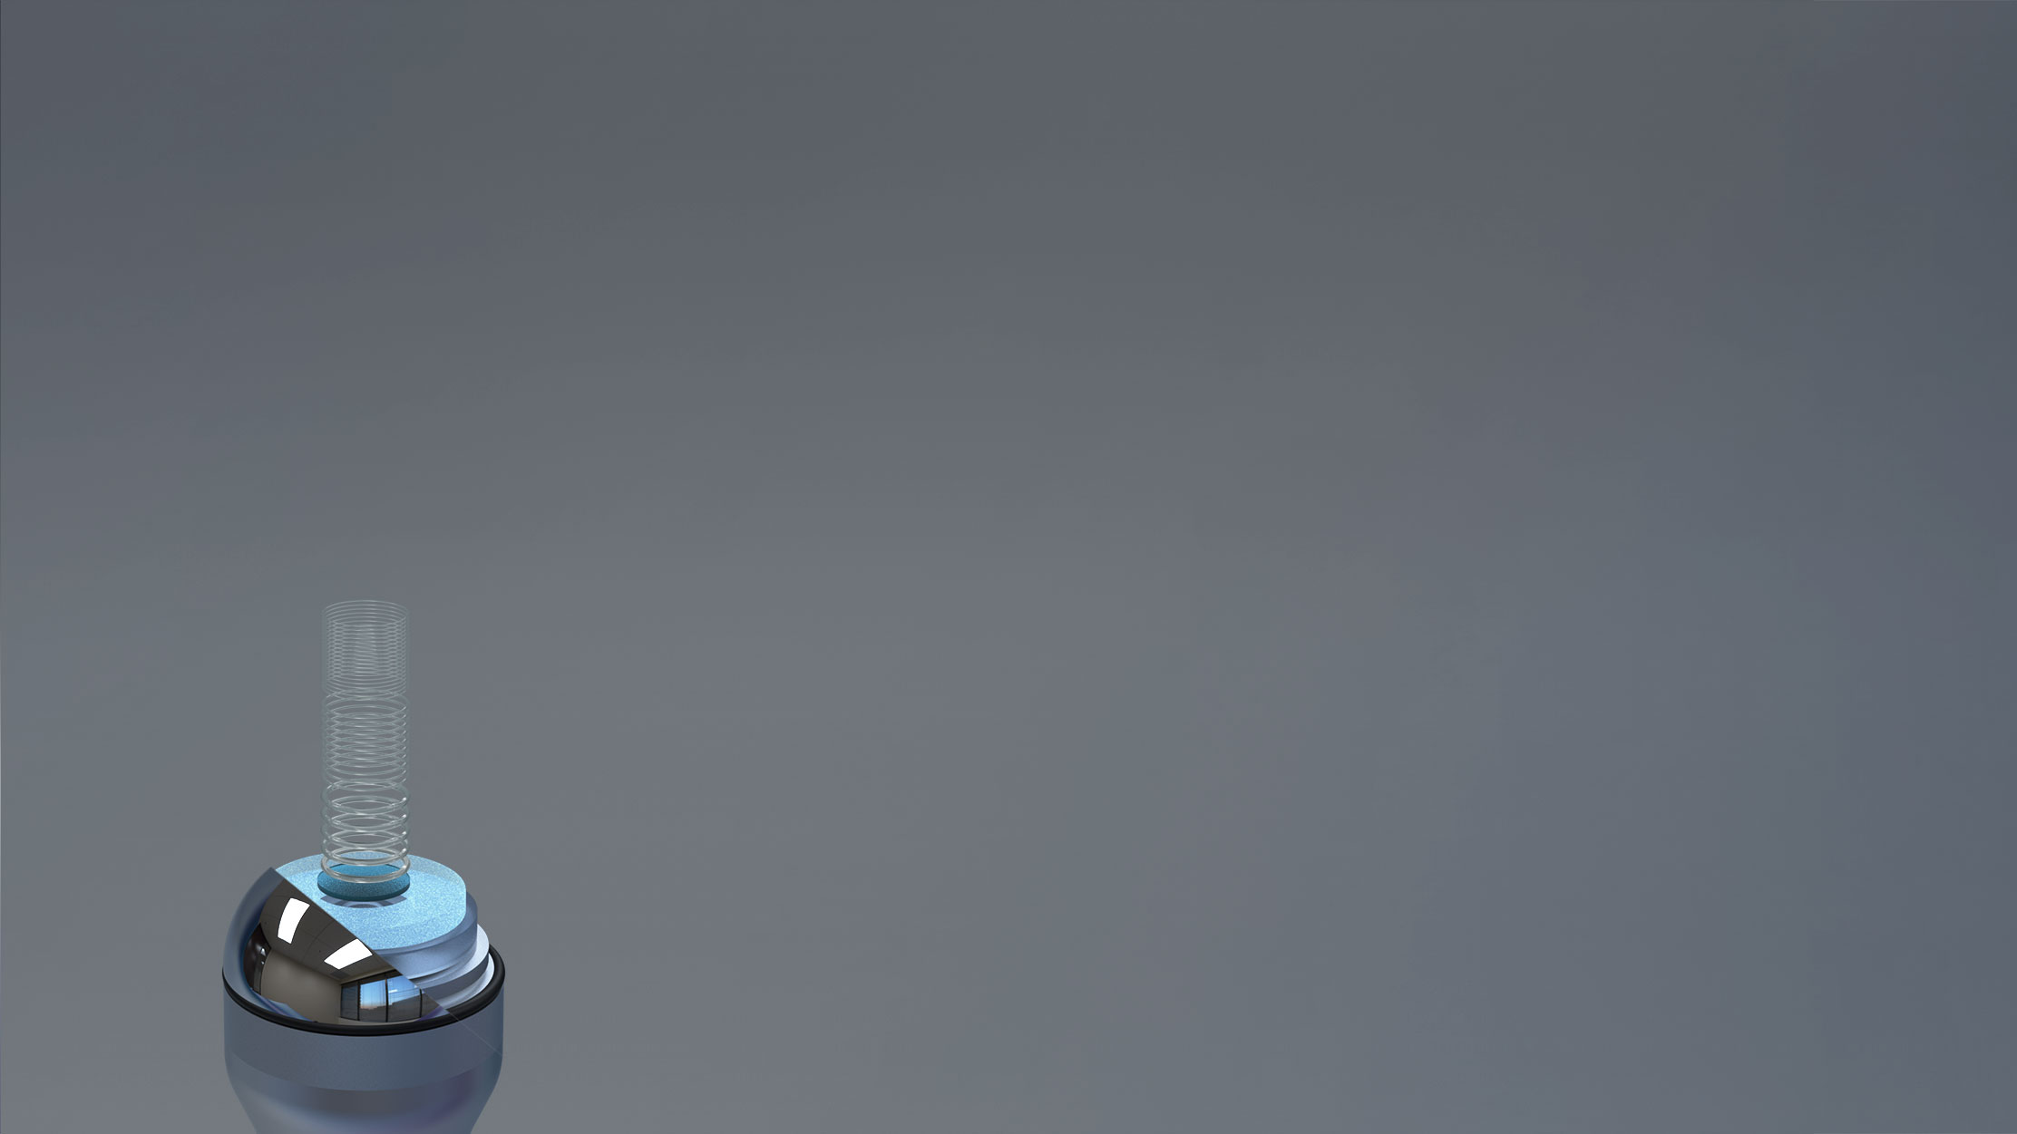
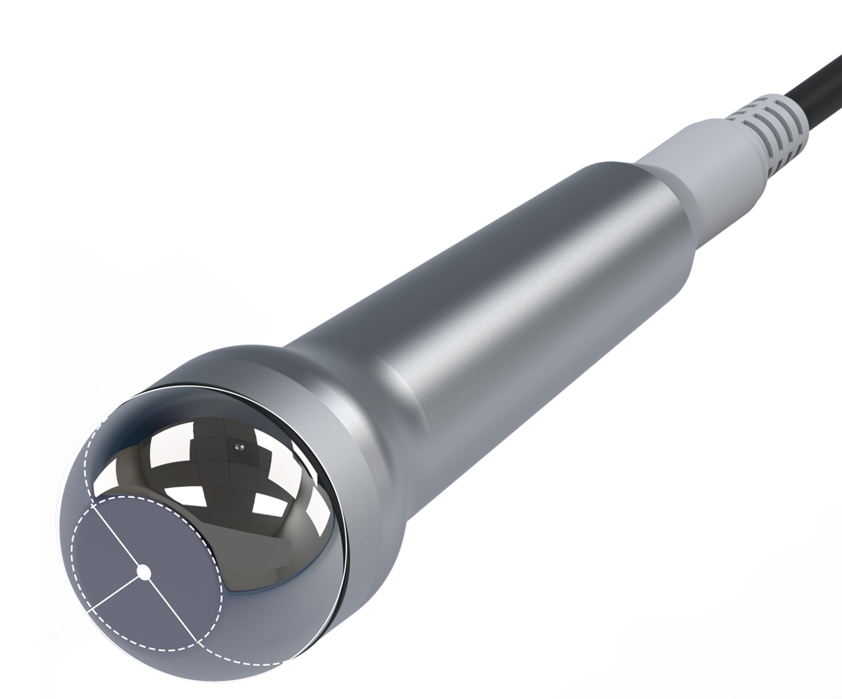
TECHNOLOGY OVERVIEW
AFS
(Adaptive Frequency System)
Compact Power, Multi-Frequency Care
3/10/17 MHz Multi-Ultrasound & 23Ø Compact Electrode for Facial Care​
Multi-frequency ultrasound with COOLING, operable together or separately
Vitamin-based cosmetics lose stability above 40 °C, leading to gradual degradation
23mm
Cooling Care for Pure Absorption!
Vitamin-based cosmetics lose stability above 40 °C, leading to gradual degradation.
UMS-C features Peltier-based cooling technology that controls the applicator temperature.
This maintains ingredient stability, prevents heat-induced alteration, and maximizes skin absorption efficiency
, Innovating Aesthetic Medical Devices for Global Healthcare.

Slide 4

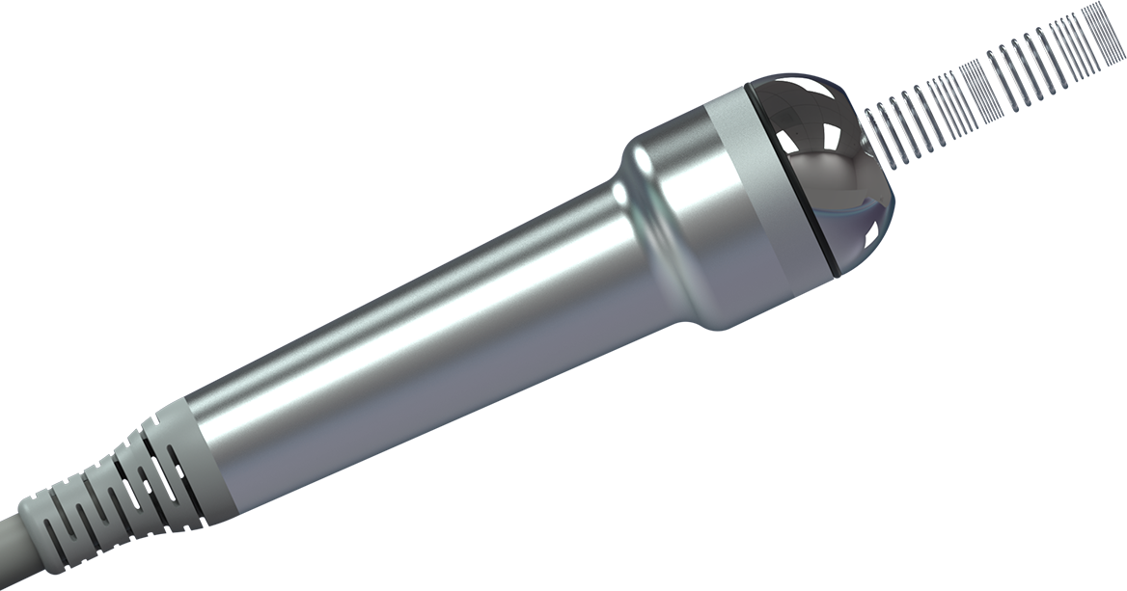
TECHNOLOGY OVERVIEW
AFS
10Mhz
(Adaptive Frequency System)
17Mhz
3Mhz
Multi-Wave Technology (3/10/17 MHz)
Stimulates different skin layers (epidermis–dermis) using multiple frequency ranges
Enables customized skin improvement with Multi-Wave Technology
Cross-frequency use extends skin contact time and enhances overall efficacy
Selectable handpieces: 3/10/17 MHz for deeper treatment
Cooling and LDM operate simultaneously to calm skin and improve treatment safety
Delivers synergistic results when combined with RF, Cavitation, and other procedures
Provides the best post-care solution after laser or peeling treatments
, Innovating Aesthetic Medical Devices for Global Healthcare.

Slide 5

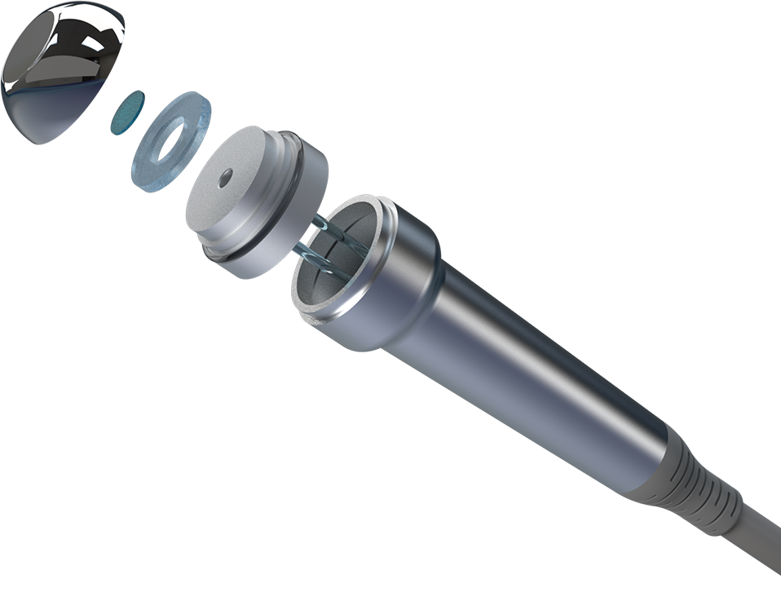
TECHNOLOGY OVERVIEW
AFS
(Adaptive Frequency System)
“Zero Heat Technology + Cooling”
Overheating Issue of Conventional Variable Ultrasound Probes
Conventional variable ultrasound probes generate excessive heat during prolonged use
Leads to skin surface temperature rise and erythema (redness)
Causes longer post-treatment calming time and overall reduced efficiency
Our Solution
Minimized Heat Generation Design Optimized ceramic probe design and impedance-matching circuitry significantly reduce handpiece heat buildup..
Effect of Cooling Function The built-in Peltier cooling system instantly soothes the skin, quickly relieving redness and heat while minimizing downtime..
Maximized Treatment Efficiency By shortening post-treatment cooling time, overall procedure time is reduced, allowing more clients to be treated efficiently and improving ROI
, Innovating Aesthetic Medical Devices for Global Healthcare.

Slide 6

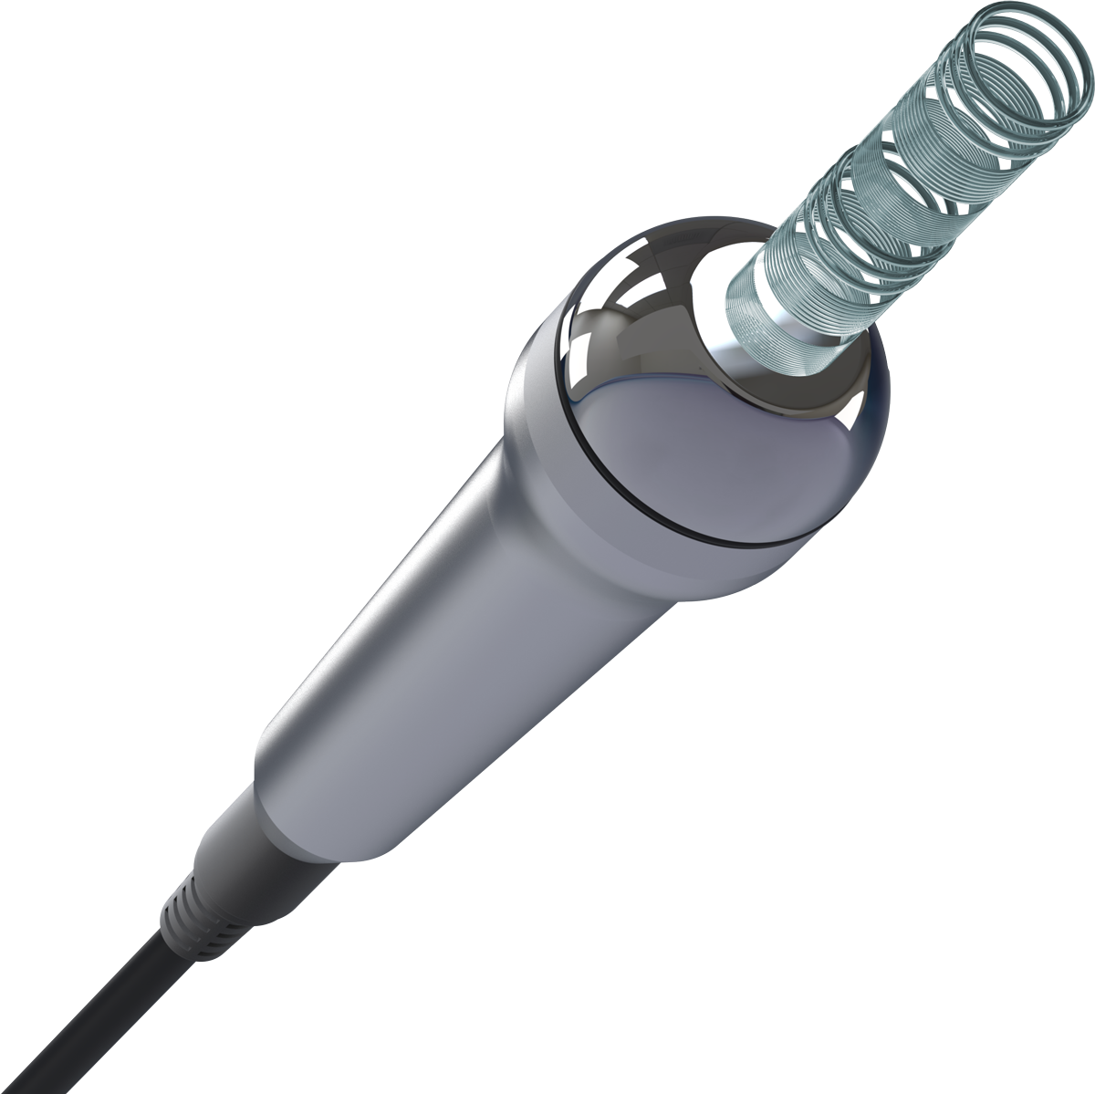
TECHNOLOGY OVERVIEW
AFS
(Adaptive Frequency System)
“One device, multi-frequency solution for complete skin care.”
Three Frequencies – All-in-One Skin Solution
Dynamic Frequency Switching technology for optimized ultrasound performance
Combined effects of anti-inflammation, regeneration, lifting, and hydration
Non-invasive procedure ensuring safety and comfort
“Premium Upselling Points that Elevate Value”
Provides multi-layered and multifunctional effects compared to single-purpose devices (e.g., MTS, RF)
Enables customized frequency combinations tailored to skin type and condition
Maximizes ROI: one device supports various treatment programs, increasing treatment diversity and revenue
, Innovating Aesthetic Medical Devices for Global Healthcare.

Slide 7
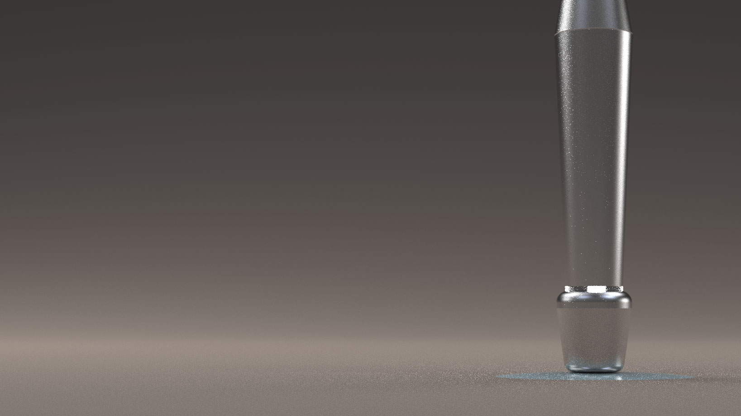
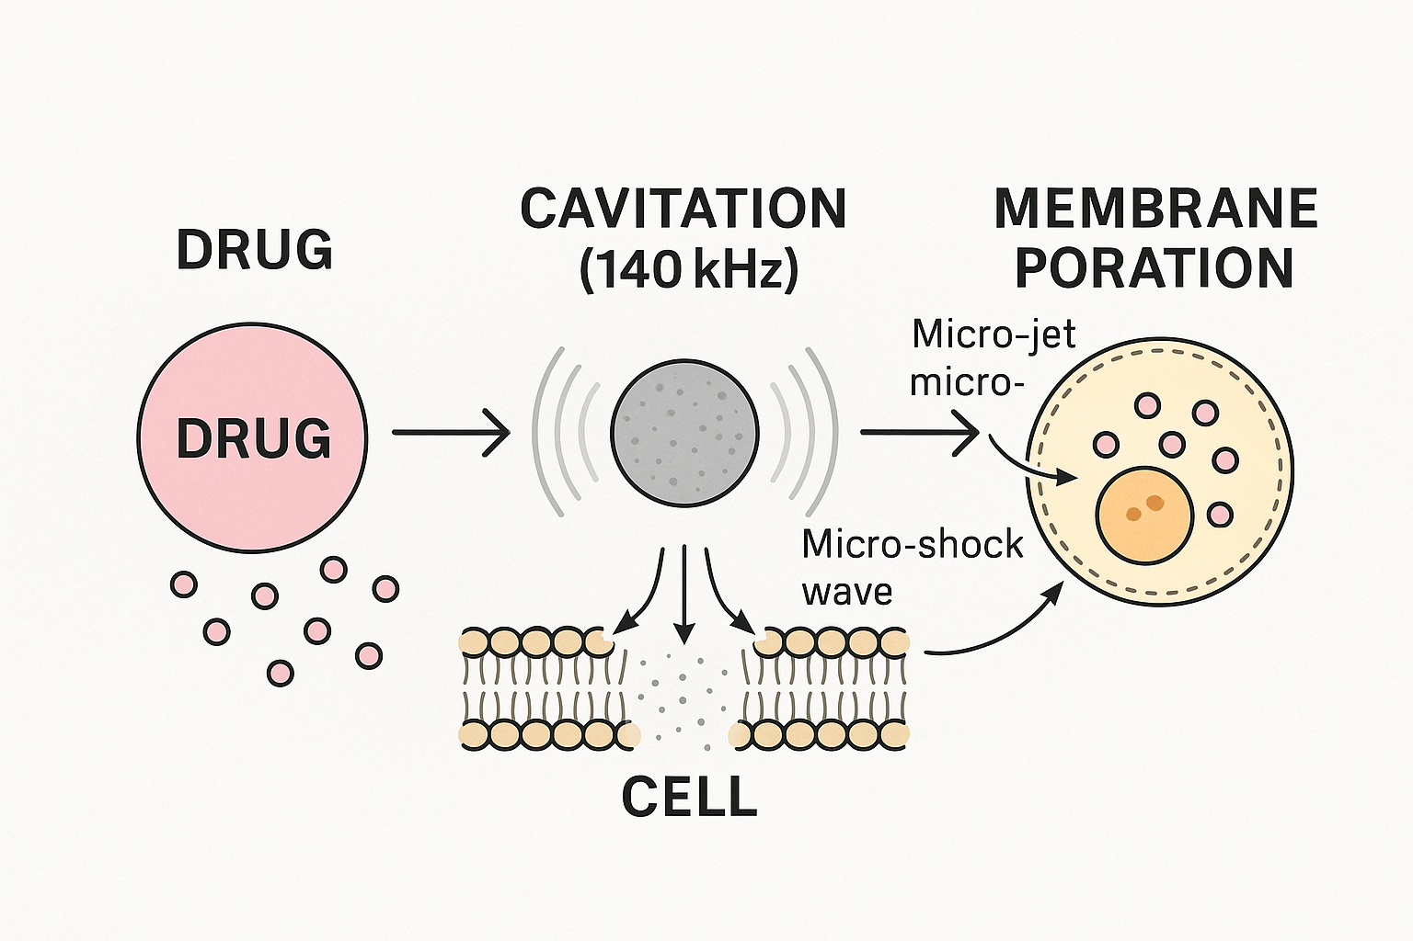
Resonating Beauty
CAS
(Cavitation Absorption System)
140 & 240kHz cavitation effect for Enhanced drug absorption
R.Sona CAS Technology
Utilizes 140 & 240kHz ultrasound cavitation effect to create microbubbles around applied substances on the skin surface
Temporarily disrupts the stratum corneum barrier, increasing skin permeability and absorption efficiency
Enables effective transdermal delivery through a non-invasive and safe mechanism
, Innovating Aesthetic Medical Devices for Global Healthcare.

Slide 8
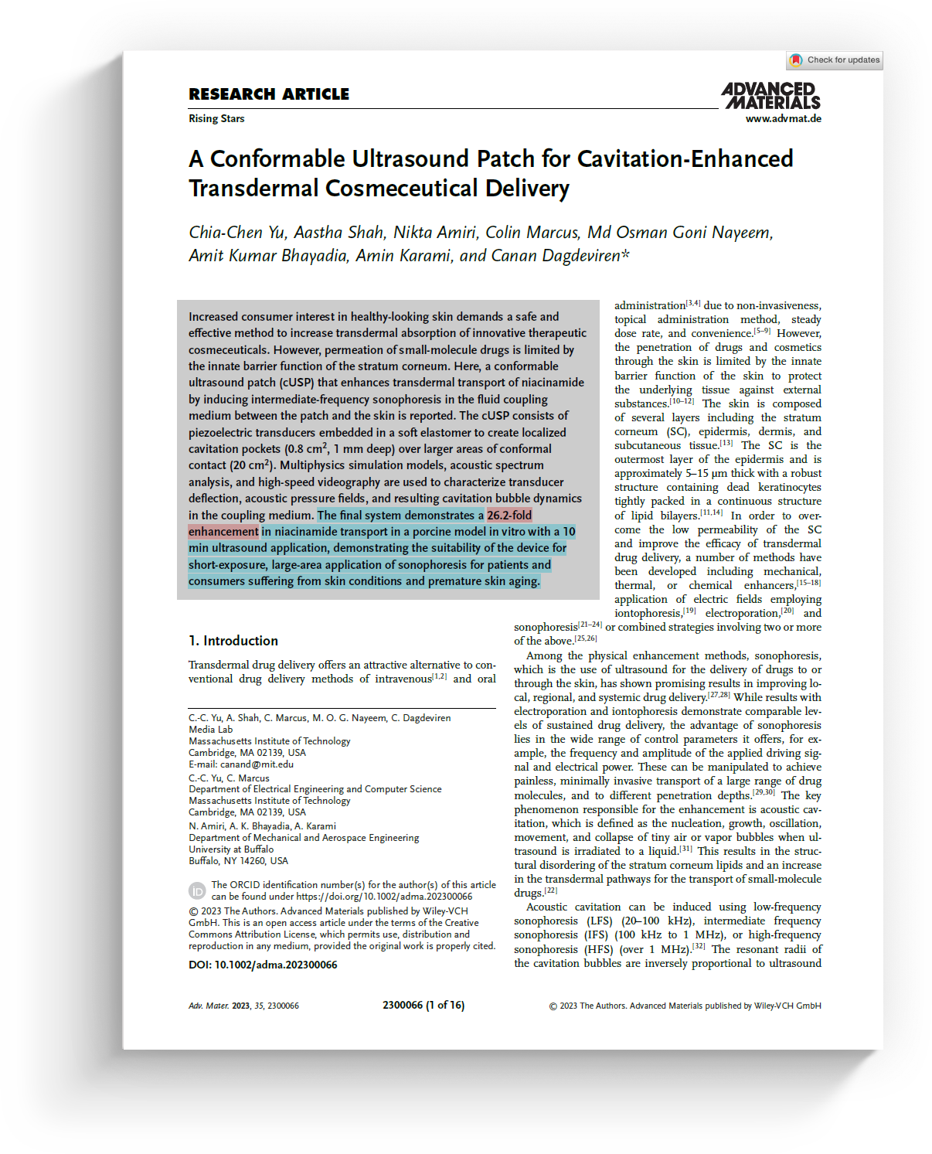

TECHNOLOGY OVERVIEW
CAS
(Cavitation Absorption System)
Advanced Materials (2023)에서 제시한 최적 범위 100Khz ̶ 1Mhz
Effective Cavitation Generation
100–200 kHz ultrasound creates, expands, and collapses microbubbles
Enhances cell membrane permeability and ingredient absorption
Safety & Efficiency Balance
High frequencies (>1 MHz) produce weak cavitation, while low frequencies (<100 kHz) may overstimulate tissues
140 & 240kHz provides the optimal balance between safety and effectiveness
Demonstrated in studies as a non-invasive and safe method for enhancing absorption
Fast Results
Studies show 26× higher niacinamide absorption after just 10 minutes of treatment
140 & 240kHz KHz frequency achieves high absorption efficiency in a short treatment time
Wide Application
Applicable to cosmetic (moisturizing, whitening, anti-aging) and medical (anti-inflammatory, regenerative) ingredients
Suitable for post-laser care, sensitive skin, and anti-aging programs
, Innovating Aesthetic Medical Devices for Global Healthcare.

Slide 9

TECHNOLOGY OVERVIEW
CAS
(Cavitation Absorption System)
Cavitation-Enhanced Absorption with 140 & 240kHz Ultrasound
Enhanced Absorption of Active Ingredients - 140 & 240kHz ultrasound cavitation creates and collapses microbubbles, micronizing cosmetic ingredients and gently exfoliating dead skin cells
- Forms new absorption pathways, maximizing skin penetration and absorption efficiency Cell Activation
- Soft ultrasound stimulation activates skin cells, improving elasticity and promoting healthy microcirculation Blood Circulation Enhancement
- Micro-vibrations help boost blood flow, resulting in a clearer and more radiant complexion. Safety
- Non-thermal, low-frequency ultrasound minimizes heat stress on the skin. - Precisely controlled micro-cavitation ensures non-invasive exfoliation without tissue damage, making it safe for sensitive skin
, Innovating Aesthetic Medical Devices for Global Healthcare.

Slide 10

TECHNOLOGY OVERVIEW
DFS
(Dual Frequency System)
Specialized for muscle contraction and relaxation
LF Mode – Promotes skin firming and lifting by stimulating muscle contraction and relaxation. HF Mode – Increases oxygen absorption within skin tissues and enhances blood circulation through bio-thermal effects.
Strong Points of
Ergonomic electrode design optimized for Gua Sha synergy effects
Operates within 1200 kHz–3000 kHz frequency range suited to varying skin thickness
Fine-tuned energy intensity minimizes discomfort during low-frequency treatments
, Innovating Aesthetic Medical Devices for Global Healthcare.

Slide 11

Thank you !

